Slide 1
ORAL NICOTINE USERS BEHAVIOUR STUDY
Research Report
Prepared by Ipsos
28 May, 2021

Slide 2
Background
1
4
Risk perception on usage of cigarettes and oral nicotine pouches
CONTENTS
Traditional tobacco products usage
2
5
Conclusions
3
Oral nicotine pouches usage behaviour

Slide 3
BACKGROUND
1

Slide 4
STUDY OBJECTIVES
This study sought to:
Tobacco products
Find out traditional tobacco products usage habits
Nicotine product category
Establish nicotine product category used and number per day
Unearth oral nicotine pouches types used
Determine oral nicotine pouches usage journey
Risk perceptions of cigarettes vs. currently used nicotine pouch
Quitting smoking journey
Demographic Profile
Understand the demographic profile of oral nicotine users
Gender
Age
Social Economic Class (SEC)
Living Standard Measure (LSM)
Profession/Occupation
Education level
Town of residence
1
2
3

Slide 5
SUMMARY OF METHODOLOGY
We approached the study as detailed below;
Strategy | Case Study
Data Collection Technique | Primary: Online Focus Group Discussions via MS Teams Secondary: Quantitative Profiling of Consumers
Target Group | Age:18-44 Years Gender: Male & Female Users of Oral Nicotine Pouches
Total number of participants | 64
Study Location | Kenya

Slide 6
Findings

Slide 7
TRADITIONAL TOBACCO PRODUCTS
2
Usage behaviour

Slide 8
TRADITIONAL TOBACCO PRODUCTS STILL PREVALENT – DRIVEN BY THE CURRENT BAN OF SOME ORAL NICOTINE PRODUCTS
People occasionally use these products when they face financial difficulties and have to fulfil their need for nicotine stimulation
USAGE TIER 1
USAGE TIER 2
USAGE TIER 3
Manufactured cigarettes
Hand-rolled cigarettes
Normally wrapped in dried banana leaf
Local name: Bakekimo
Kuber is a popular brand of loose snus
SNUFF/SNUS

Slide 9
USERS ARE COGNISANT OF THE DANGERS OF SMOKING MANUFACTURED CIGARETTES
Nevertheless, despite the many frustrations experienced while smoking manufactured cigarettes, product stickiness and the ban of some oral nicotine products in Kenya promote continued usage
JOYS
FRUSTRATIONS
Nice sensation/stimulation
Stress reduction
Relaxation
Expensive
Short-lived sensation
After-smell
Bad breath
Teeth stain
Knowledge of the resultant health risks
Gender stigmatisation
Sticks not waterproof
Addictive nature
Breathing difficulties
Lowered productivity due to the overstimulation
Affecting others through passive smoke
Need to isolate self

Slide 10
IN THEIR OWN WORDS…
I must smoke a cigarette first thing in the morning, that is when I feel I am alive. It gives me stimulation, I feel good.”
18-24 years
When I smoke, I must hide because of gender stigmatisation. A woman being seen in public smoking looks like you are committing a big sin which stresses me.”
30-35 years
For me, the first frustration is the smoke. When I get to work, people complain but I am used to it, I don't care.”
25-29 years

Slide 11
WHEN ORAL NICOTINE POUCHES WERE INTRODUCED INTO THE KENYAN MARKET, THEY HELPED USERS IN THEIR JOURNEY TO SMOKE FEWER CIGARETTES
The temporary ban on oral nicotine pouches in the market frustrates many consumers, making them revert to smoking cigarettes
Smoking less compared to 2 years ago
Triggers
Introduction of oral nicotine pouches in the market
Reduced disposable income
Extent of mentions

Slide 12
IN THEIR OWN WORDS…
Before, I was smoking more. I could even smoke one packet of cigarettes in a day. Introduction of oral nicotine pouches in the market made me to reduce smoking, then when they were banned, I found myself even smoking more than before. I just don’t know how to stop smoking.”
Over 35 years
There were some nicotine pouches that came onto the market, and I used to take those most of the time and I somehow forgot about cigarettes. But when the nicotine pouches were banned, I went back to cigarettes.”
When nicotine pouches were introduced, I started smoking less. They made it easier to get the same sensation without having to smoke. Also, when you want to smoke, you have to isolate yourself but with the pouches, you can continue doing what you were doing.”

Slide 13
CUMBERSOME PREPARATION DISCOURAGES USAGE OF HAND-ROLLED CIGARETTES
Those who prefer hand-rolled cigarettes cite that they provide a better “kick” than manufactured
cigarettes
JOYS
FRUSTRATIONS
Strong sensation/stimulation compared to manufactured cigarettes
Rolling is cumbersome
Too much smoke
Bad breath
“Rolling is a bit cumbersome. Also, I think it just has so much smoke; your hands will be smelling of tobacco and the breath is terrible.” 30-35 years

Slide 14
ORAL NICOTINE
3

Slide 15
Oral nicotine usage behaviour

Slide 16
ORAL NICOTINE PRODUCTS USAGE DRIVEN BY BOTH INTRINSIC AND EXTRINSIC ATTRIBUTES
Notwithstanding the short existence of some oral nicotine products in the market, consumers shower them with a lot of praise, especially because these products help them smoke less manufactured cigarettes
INTRINSIC DRIVERS TO USAGE
EXTRINSIC DRIVERS TO USAGE
Strong stimulation – Consumers say oral nicotine products provide a quick kick
Flavours – The flavours in the various oral nicotine products are a celebrated intrinsic attribute, especially because they solve one of the key cigarette dislikes, namely tobacco smell
Tobacco free – This is another driver to usage as consumers deem these products to be a safer/healthier stimulant
Withdrawal purposes – Consumers trying to withdraw from manufactured cigarette smoking see oral nicotine products as a great and only alternative
Low-key nature of oral nicotine products, especially the nicotine pouches, which look like chewing gum
The need to discreetly consume tobacco without inconveniencing others or exposing their ‘bad’ habit
Usage of the nicotine pouches, especially the all-white ones, is perceived to not impact the user’s oral hygiene i.e., no staining or bad breath

Slide 17
CURRENT BAN ON SOME ORAL NICOTINE PRODUCTS IN KENYA RESTRICTING USAGE
Shisha and oral nicotine pouches are currently illegal in Kenya
HEATED TOBACCO PRODUCTS I.E., SHISHA
E-CIGARETTES/VAPING PRODUCTS
ORAL NICOTINE POUCHES
High awareness of shisha in the oral nicotine products category
Usage is occasional i.e., house parties because of its ban in public entertainment spots
Preferred by some because of its classy image
Variety of flavours gives it an edge
Perceived as a more suitable product for women than men
Perceived to be expensive, thus a luxury to most consumers, which contributes to low usage
Those who use appreciate the classy image it portrays
Consumers are well conversant with the all-white nicotine pouches (white nicotine filling in a white bag)
Before the ban on oral nicotine pouches in Kenya, they had quickly become a cigarette alternative
A few participants cited to have used a brown nicotine pouch (brown tobacco filling in a brown bag) brand called Thunder, but discontinued use because of its extremely high kick and experiencing nausea

Slide 18
DESPITE ITS BAN, SHISHA IS STILL SOLD IN VARIOUS ENTERTAINMENT VENUES
Smoking shisha is deemed to be ‘cool’ due to the sight of smoke billowing out of the mouth and nose. Although currently illegal in Kenya, consumers are able to get it in some public places as well as in their homes
JOYS
FRUSTRATIONS
Strong sensation/stimulation compared to manufactured cigarettes
Variety of flavours
Makes the user look classy
Perceived as a product mainly ideal for girls
Currently illegal in Kenya
Expensive
Heated tobacco products
“The biggest joy for me is the highness and also it is a fun product to consume.” 18-24 years

Slide 19
COST AND UNAVAILABILITY HAVE RENDERED E-CIGARETTES UNPOPULAR
There is a low usage incidence of e-cigarettes
JOYS
FRUSTRATIONS
Makes the user look classy
Non-combustible
Expensive
Not readily available locally
E-cigarettes/vaping products
“E-cigarettes are fancy, when I take one out, everybody looks at me.”
30-35 years
“E-cigarettes are expensive, they are not for a hustler (someone struggling financially).” Over 35 years

Slide 20
TOBACCO FREE AND WITHDRAWAL PURPOSES ARE KEY DRIVERS TO USAGE OF ALL-WHITE NICOTINE POUCHES
The pros of using the all-white/tobacco free nicotine pouches far outweigh the cons
JOYS
FRUSTRATIONS
Strong sensation/stimulation
Offers a quick ‘kick’ within minutes of use
Tobacco-free
No tobacco smell
Nice aroma
Diversity of flavours
No teeth stain
Concealable, thus can be consumed in public (looks like chewing gum)
Long lasting
No smoke exposure to others
Recyclable containers
No bad breath/taste in the mouth
Expensive (compared to manufactured cigarettes)
Unavailability/withdrawn from the market
Poor distribution before withdrawal from the market
The price fluctuated depending on location (used to be cheaper in Nairobi than other locations like Mombasa)
All-white nicotine pouches

Slide 21
IN THEIR OWN WORDS…
Personally, I thought oral nicotine pouches would be my substitution to smoking cigarettes. When it came onto the market, I felt for the first time in Kenyan history I had a product that would prevent me from smoking cigarettes.”
30-35 years
Oral nicotine pouches do not have that smoky smell. I really liked it a lot.”
30-35 years

Slide 22
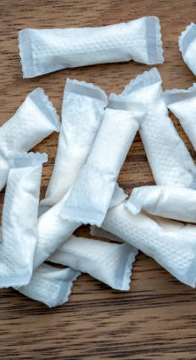
ALL-WHITE NICOTINE POUCHES HAVE SEVERAL TRIAL AND CONTINUED USAGE TRIGGERS
Curiosity was a big trial trigger. The drivers for continued usage include:
As a substitute for manufactured cigarettes
For the majority of consumers, their motivation to continue using the all-white nicotine pouch was the fact that it aided them in their cigarette quitting journey
Ease of usage/ low-key nature
Another motivation to continued usage was that the all-white nicotine pouch did not require a lot of work to use – it is just placed between the gums and lip
It can also be used discreetly
Safer to use vs. manufactured cigarettes
Consumers deem oral nicotine pouches a healthier stimulant compared to manufactured cigarettes

Slide 23
THE WITHDRAWAL OF ALL-WHITE NICOTINE POUCHES AFFECTED CONSUMER USAGE JOURNEY
Consumers engaged with the product for a short duration before its withdrawal from the Kenyan market
Usage frequency
Before its ban, consumers used the pouches daily, which helped many in their cigarette quitting journey.
However, some still smoked and used the pouch at different times of the day as cigarette smoking is entrenched in their lives.
Number of pouches used per occasion
All consumers cited that they would use one pouch at a time and use between 2-5 pouches in a day.
Interestingly, some users would re-use a pouch later after removing from the mouth if they thought the nicotine hadn’t been fully depleted.
Usage habits
Oral nicotine is used in varied ways, with the biggest consideration being to ensure not to swallow the pouch
Between the gum and upper lip
Between the gum and lower lip
Between the gum and side of the mouth
Under the tongue
Duration of usage
The usage duration is subjective and dependent on how stimulated the user feels
Minimum usage duration: Approximately 10-15 minutes
Maximum usage duration: About 20 minutes

Slide 24
IN THEIR OWN WORDS…
The person who introduced nicotine pouches to me did not tell me the minimum or maximum duration that I should have it in my mouth, I was just told that when the steam is over I remove it. In fact, the first day I got one, I stayed with it for 30 minutes.”
25-29 years
I would put it under the lower lip, sometimes under the tongue or even sideways, depending on the way I felt like placing it.”
30-35 years
If I’m using the pouch and I must do something like go to a meeting while in the office, I would remove and re-use it later. And the good thing about it, it does not have any dirt, it does not stain your teeth, so I used to be good.”
30-35 years

Slide 25
BECAUSE OF THE SUDDEN BAN ON ORAL NICOTINE POUCHES, CONSUMERS HAD NOT INTERACTED WITH THEM LONG ENOUGH
Consumers have not interacted with many brands of all-white oral nicotine pouches
FLAVOURS AWARE OF
Berry Frost
Tropical
Menthol/Mint
FLAVOURS EVER USED
Berry Frost
Tropical
FLAVOUR USED MOST OFTEN
Tropical
Was readily available
Nice menthol taste
“Tropical is the one that I would mainly get around where I stay. The Berry Frost was not very common.”
30-35 years

Slide 26
ORAL NICOTINE POUCHES CONSIDERED AS AN IDEAL CIGARETTE SUBSTITUTE
Usage was driven by the need to cut down on smoking
LIKES
Ideal substitute for manufactured cigarettes i.e., gives user similar effects as cigarettes
Discreet
Can be used without inconveniencing other people i.e., no emission of smoke
Easy to use i.e., placing pouch under the lip
Convenient to use i.e., portable and can be used anywhere
Highly stimulating i.e., the effects last longer than cigarettes
Nicotine pouches are perceived as classy and aspirational, giving the user a ‘cool’ image
Perceived to have a less negative impact than cigarettes
Appealing flavours i.e., Berry Frost and Tropical
DISLIKES
Due to the ban, nicotine pouches are no longer available
Perceived to be more expensive compared to manufactured cigarettes
Users said pouches caused headaches
Limited availability i.e., nicotine pouches were only available at the supermarket and not at other retail outlets

Slide 27
IN THEIR OWN WORDS…
For me, a nicotine pouch is easier to use, it does not burn you the way cigarettes do. It will also not stain your teeth. I found that a few of my friends are ok using it and that is what convinced me to start using it.”
18-24 years

Slide 28
Oral nicotine pouches user profile

Slide 29
UPTAKE OF ORAL NICOTINE POUCHES
Higher among male than female
GENDER
AGE
Base n=64; All participants

Slide 30
ORAL NICOTINE POUCH USERS STILL SMOKING CIGARETTES LARGELY DRIVEN BY ITS BAN IN KENYA
Products consumed in the last 30 days (except for oral nicotine, which refers to usage in the past year)
Important note:
Oral nicotine usage is 100% by design; all participants had to be oral nicotine users to qualify for the study.
Asterisk (*) means the sample size is small and therefore the data should be read with caution.
Base n= Indicated against each product

Slide 31
3 OUT OF 4 ORAL NICOTINE POUCH USERS WOULD TAKE LESS THAN 5 POUCHES A DAY
Products consumed – Average Daily Consumption
 | Oral nicotine pouches | Manufactured cigarettes sticks | Heated tobacco products sticks | E-cigarette's cartridges | Snus/snuff portions | Hand-rolled cigarettes sticks | Chewing tobacco bags/pouches
Base | 64 | 62 | 19* | 8* | 5* | 4* | 3*
Less than 5 | 75% | 35% | 89% | 25% | 80% | 75% | 67%
5 to 8 | 20% | 34% | - | 63% | - | 25% | -
8 to 10 | 3% | 27% | - | - | - | - | -
More than 10 | 2% | 3% | - | - | 20% | - | 33%
I don’t know/can’t tell | - | - | 11% | 13% | - | - | -
Important note:
Asterisk (*) means the sample size is small and therefore the data should be read with caution.

Slide 32
A NOTEWORTHY PROPORTION OF ORAL NICOTINE POUCH USERS
Users are college-educated business people
EMPLOYMENT STATUS
EDUCATION LEVEL
Base n=64; All participants

Slide 33
NICOTINE POUCH USERS ARE IN HIGH AND MID SOCIAL CLASSES
Living standard measure (LSM) & socio-economic class (SEC)
LSM | Total | SEC
8 | 2% | C1
9 | 2%
10 | 3%
11 | 3%
12 | 17% | AB
13 | 22%
14 | 23%
15 | 17%
16 | 5%
17 | 6%
Base n=64; All participants

Slide 34
UPTAKE OF ORAL NICOTINE POUCHES IS HIGHER AMONG URBAN DWELLERS
Current town of residence

Slide 35
The typical oral nicotine pouch user in Kenya is…
An economically empowered urban male youth.

Slide 36
RISK PERCEPTIONS ON USAGE
4
Manufactured cigarettes vs. oral nicotine pouches

Slide 37
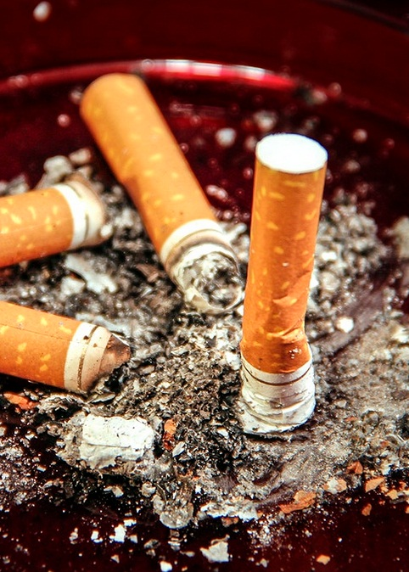
CONSUMERS ARE WELL AWARE OF THE RISKS OF CIGARETTE SMOKING
Nevertheless, although some are struggling to quit; being addicted to the nicotine in tobacco makes quitting a difficult task
As per consumer feedback, systems within the human anatomy that are at risk due to cigarette smoking include:
Oral system
Causes cavities
Loosens teeth
Stains the teeth
Causes bad breath
Respiratory system
Predisposes one to tuberculosis
Causes shortness of breath
Leads to lung cancer
Causes chronic bronchitis
Reproductive system
Causes infertility
Causes impotence
Causes miscarriages
Circulatory system
Causes heart disease

Slide 38
OLDER SMOKERS ARE MORE WORRIED ABOUT DISEASE-SPECIFIC RISKS
The top concern of younger smokers is ADDICTION
Manufactured cigarettes side effects | RANKING BY AGE |  |  |  | OVERALL RANKING
 | 18-24 Yrs | 25-29 Yrs | 30-35 Yrs | Over 35 Yrs
Addiction | 1 | 1 | 2 | 5 | 1
Disease-specific risks | 5 | 3 | 1 | 1 | 2
Stained teeth | 3 | 12 | 8 | 9 | 8
Loss of sense of taste | 8 | 8 | 7 | 7 | 7
Loss of sense of smell | 10 | 7 | 9 | 11 | 9
Bad breath | 7 | 12 | 11 | 8 | 10
Bad taste in the mouth | 9 | 11 | 12 | 8 | 11
Poor gum health | 6 | 10 | 5 | 6 | 6
Eye irritation | 12 | 6 | 6 | 13 | 9
Face aging | 14 | 9 | 7 | 12 | 12
Stains on skin/hands | 11 | 12 | 11 | 10 | 13
Wheezing | 2 | 4 | 9 | 3 | 4
Coughing | 2 | 2 | 10 | 2 | 3
Elevated heart rate | 4 | 3 | 3 | 6 | 3
Reduced athletic ability | 13 | 5 | 4 | 4 | 5

Slide 39
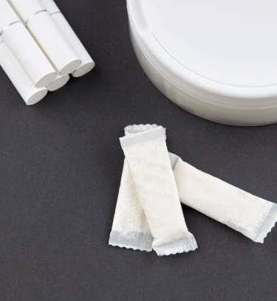
MOST CONSUMERS DO NOT ASSOCIATE ORAL NICOTINE POUCHES WITH ANY SIDE EFFECTS
However, a few consumers cited some perceived side effects, which could only be verified after lengthy usage. Overall, consumers unanimously agreed that oral nicotine pouches have fewer side effects compared to manufactured cigarettes
SIDE EFFECTS
Teeth damage through corrosion
Lip and gum damage through blistering
Causes constipation if many pouches are used
“I don’t think there are any side effects. I think the oral nicotine pouch is very good.” 18-24 Years
“We have been taught that cancer is caused by smoke that goes to the lungs, but nicotine pouches don’t have smoke so if you give me those pouches, I am okay.” 25-29 years

Slide 40
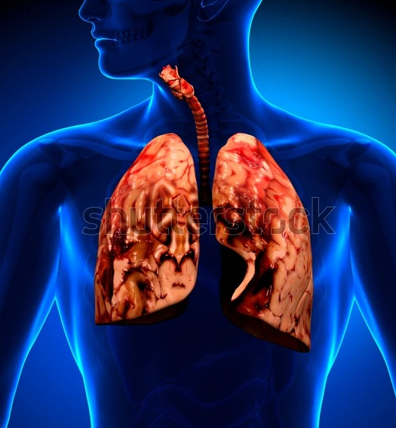
GRAPHIC WARNINGS ON PACKS WILL NOT DETER USAGE
Although graphic warnings on packs educate and remind consumers of the side-effects of the products, they do not affect product usage in any way. Users always choose to ignore those warnings.
LIKELY IMPACT OF GRAPHIC WARNINGS ON ORAL NICOTINE PACKS
Use less
Use same/no impact
Use more
Graphic warning on manufactured cigarette pack

Slide 41
IN THEIR OWN WORDS…
I use what is inside, whatever is written on the pack does not concern me.”
25-29 years
Even on cigarette packs, we normally see the same graphic warnings and we still take the cigarettes.”
30-35 years
Honestly speaking, if the graphic warnings on packets of cigarettes have never deterred anyone from smoking, I doubt that graphic warnings on oral nicotine pouch packs would work.”
Above 35 years

Slide 42
CONCLUSIONS
5

Slide 43
CONCLUSIONS
The use of manufactured cigarettes is still prevalent, with most users admitting that they are addicted and struggling to quit despite being cognisant of the many side effects
The societal disapproval of manufactured cigarettes usage causes many users to use the product in secret, especially female smokers
The introduction of oral nicotine pouches in 2019, which was deemed to have fewer side effects than cigarettes, resulted in quick uptake among cigarette smokers who had been struggling to quit. Many referred to nicotine pouches as the perfect alternative to smoking cigarettes
Because of oral nicotine pouches, most cigarette smokers admitted to have reduced smoking until the pouches were banned in 2020, which resulted in them reverting to cigarettes

Slide 44
Appendix

Slide 45
IPSOS AFFILIATIONS & CERTIFICATION
MARKETING AND SOCIAL RESEARCH ASSOCIATION
ESOMAR
ISO 20252:2012 CERTIFIED
Ipsos Kenya is a key members the Market and Social Research Association of Kenya
MSRA is an industry regulating organisation that was forged to drive quality assurance.
The world association for market, social and opinion research, unites a global membership of 4900 members from 130 countries
The ESOMAR Membership mark signals an endorsement of ethical standards and provides a valued means of recognition within the wider marketing and research industries.
Our methods & practices are as per ISO. We are in compliance with ISO 20252:2012

Slide 46
QUALITY ASSURANCE & DATA SAFETY
Ipsos is committed to protecting the client’s confidentiality
Every member of Ipsos involved in this study is committed to this policy and will under no circumstances share any information made available to Ipsos by the client, either in writing or verbally.
Any information received from clients will be held in the utmost confidence by Ipsos staff. Ipsos respects the client rights and signs confidentiality agreements, if need be.
‹#›
© 2015 Ipsos.

Slide 47
ABOUT IPSOS
GAME CHANGERS
Ipsos is the third largest market research company in the world, present in 90 markets and employing more than 18,000 people.
Our research professionals, analysts and scientists have built unique multi-specialist capabilities that provide powerful insights into the actions, opinions and motivations of citizens, consumers, patients, customers or employees. Our 75 business solutions are based on primary data coming from our surveys, social media monitoring, and qualitative or observational techniques.
“Game Changers” – our tagline – summarises our ambition to help our 5,000 clients to navigate more easily our deeply changing world.
Founded in France in 1975, Ipsos is listed on the Euronext Paris since July 1st, 1999. The company is part of the SBF 120 and the Mid-60 index and is eligible for the Deferred Settlement Service (SRD).
ISIN code FR0000073298, Reuters ISOS.PA, Bloomberg IPS:FP
www.ipsos.com
In our world of rapid change, the need for reliable information to make confident decisions has never been greater.
At Ipsos we believe our clients need more than a data supplier, they need a partner who can produce accurate and relevant information and turn it into actionable truth.
This is why our passionately curious experts not only provide the most precise measurement, but shape it to provide True Understanding of Society, Markets and People.
To do this we use the best of science, technology and know-how and apply the principles of security, simplicity, speed and substance to everything we do.
So that our clients can act faster, smarter and bolder.
Ultimately, success comes down to a simple truth:
You act better when you are sure.

